Slide 1
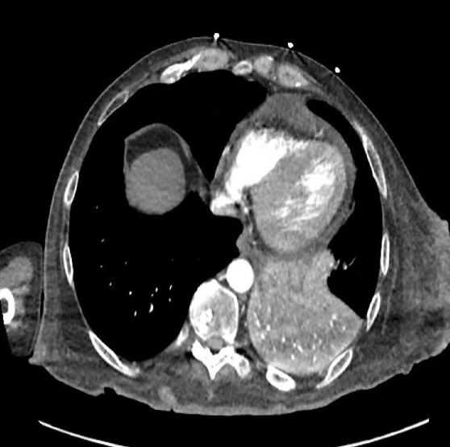
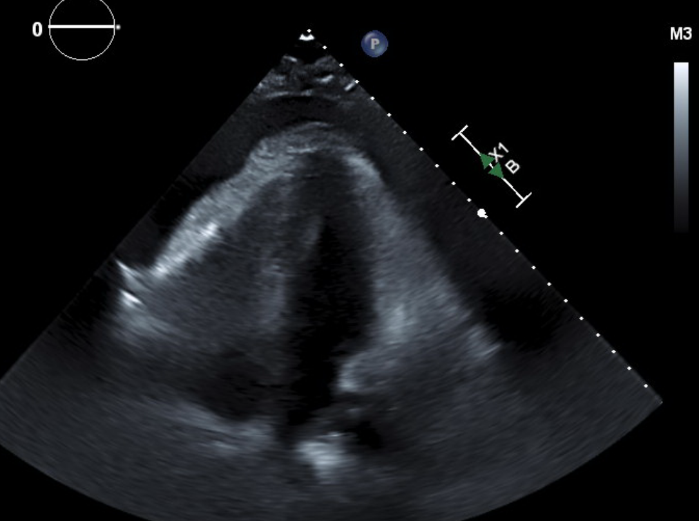
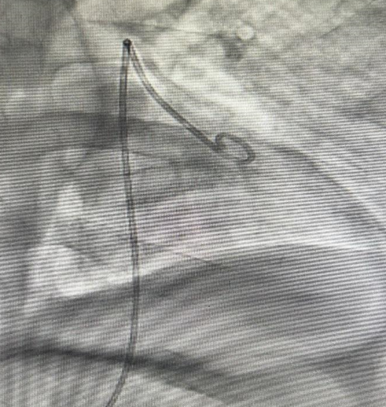
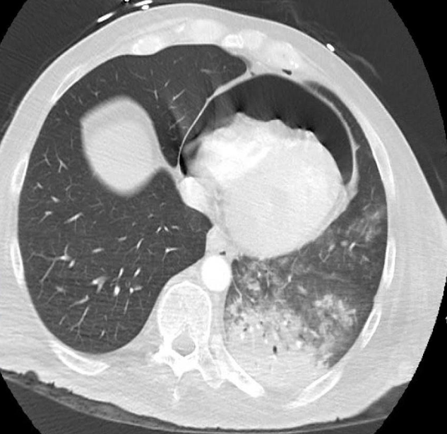
A Rare Triple Threat: Pneumomediastinum, Pneumopericardium, and Pericarditis
Riverside
Medical Center
Kankakee, Illinois
¹dali@rhc.net
Dureshahwar Ali D.O.¹, Vijay Haryani M.D.
Riverside Medical Center, Heart and Vascular Institute; Kankakee, Illinois
Background
Pneumopericardium following pericardiocentesis can result from communication between the pleural and pericardial space, secondary to air leakage within or around the drainage system, or gastric/transverse colon and pericardial fistula.
Pre-procedure review of anatomic landmarks on imaging can help to reduce complications associated with pericardiocentesis.
Similar to a pericardial effusion, pneumopericardium causing tamponade requires emergent decompression.
Figure 1
Figure 2
Tension pneumopericardium is a rare, life-threatening condition that can present as a complication of pericardiocentesis.
PISA 0.6 cm
Case Presentation
40-year-old morbidly obese male was admitted for hypotension and acute hypoxic respiratory failure requiring BiPAP. CT angiogram revealed findings consistent with pneumonia with pneumomediastinum and a moderate sized pericardial effusion. It also showed bowel distension. Echocardiogram showed a large pericardial effusion consistent with tamponade physiology. Due to the patient’s hemodynamic instability, emergent pericardiocentesis was performed under fluoroscopy and ultrasound guidance. During aspiration, 50 mL of non-hemorrhagic frothy fluid was retrieved, but was followed by air, which was noted on fluoroscopy.
Axial view of CT chest with contrast obtained on admission demonstrating a pericardial effusion.
TTE showing a large pericardial effusion.
Figure 3
Figure 4
Decision-Making
CT chest following pericardiocentesis showed pneumopericardium with tension tamponade and small amount of air under the diaphragm. Differential included a pleural-pericardial fistula, a leak in the tubing used to drain the pericardium during pericardiocentesis, or bowel perforation. Patient underwent pericardial window and catheter placement in pericardium with resolution of pneumopericardium. Additional exploration showed small slit in the gastric serosa and musculature which was closed with sutures.
Air noted in the pericardial space during pericardiocentesis.
Axial view of CT chest after pericardiocentesis demonstrating large pneumopericardium
Conclusions
The etiology of pneumopericardium is likely a result of iatrogenic perforation of stomach during pericardiocentesis. Pneumopericardium is a rare complication carrying a high mortality rate. Early recognition and decompression is crucial.
Disclosure Information
Nothing to disclose

