Slide 1
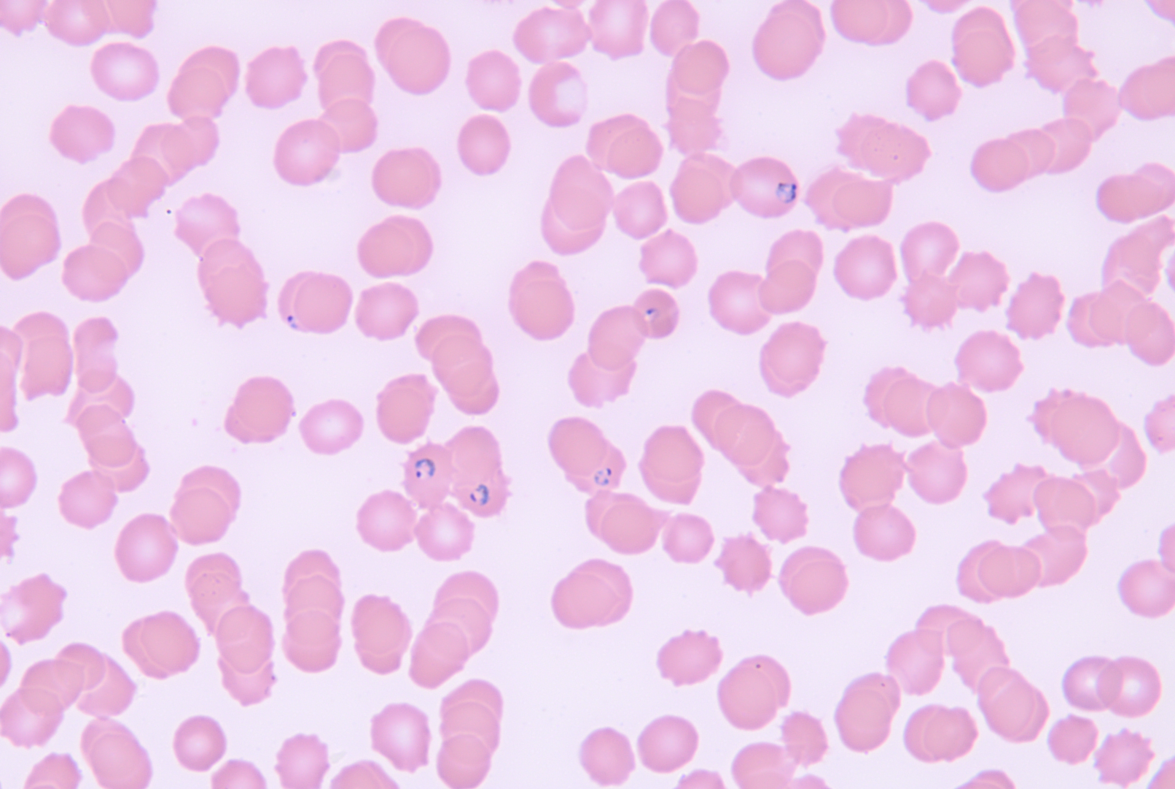
Cerebral Malaria: A Morbid Rise in Parasitemia
Riverside
Medical Center
Kankakee, Illinois
^{Khamann@rhc.net}
Kyle Hamann, DO; Brandon Segrest, DO; Matthew Tayon, DO; Thomas Betlej, MD
Cerebral Malaria is a well-documented, deadly disease. According to the WHO, cerebral malaria is the presence of coma existing at least one whole hour after documented seizure and without other explainable contribution to altered mental status with plasmodium falciparum on peripheral blood smear [1]. This condition accounts for only 1.12% of all cases of malarial infection and primarily involves children in Sub-Saharan Africa [2]. Recognition of parasitemia levels and access to first line treatment is paramount in preventing catastrophic outcomes.
Outpatient malaria smear resulted showing significant parasitemia at 10.8%. We were unable to start artesunate or quinine as they were also not readily available in the area. IV doxycycline and ceftriaxone started in absence of first line treatment. His clinical condition continued to deteriorate, and rapid response was called. He was transferred to the ICU and intubated due to low GCS. Ultimately, the patient went into cardiopulmonary arrest and CODE BLUE was called. Code was run according to ACLS protocol however ROSC was not achieved. Final peripheral smear taken earlier that morning showed that parasitemia had more than 24.8%.
Discussion
Prompt recognition of parasitemia level is key to accurate triage and treatment. WHO describes high parasitemia as 5% in low incidence areas and 10% in high incidence areas as severe malarial infections[5]
Cerebral Malaria requires first line treatment. First line indicated treatment is Artemisinin derivative (Artesunate) followed by Quinine derivative as second choice agent. [3]
Medication was not readily available in Kankakee are. It took roughly 3 days from act of prescription until Coartem was available for pick up. Artesunate was available at hospital within range of emergent delivery however said hospital was not willing to assist.
Introduction
Figure 1: Peripheral blood smear; pathologist review: Normocytic, normochromic anemia with moderate anisocytosis and increased polychromatophilic cells. Frequent RBCs containing malarial ring forms are identified. Thrombocytopenia with unremarkable morphology. Adequate WBCs, predominantly neutrophils with frequent band forms.
Case Summary
We present a 66 y/o male who presented to Riverside after a one month stay in Zambia. There was questionable use of prophylactic doxycycline prior to trip with confirmed absence of usage after returning. While in Zambia, patient had fever and chills assumed to be malaria. He was treated with one injection of an unknown drug which did help resolve symptoms. Shortly after returning, he started having fevers and cough again. He presented to his PCP’s office where malaria smear was ordered and Coartem prescribed, however not readily available in the area. On presentation to hospital, patient was encephalopathic, unable to follow commands, hypothermic, and with lactate of 10.5.
References:
Idro R, Marsh K, John CC, Newton CR. Cerebral malaria: mechanisms of brain injury and strategies for improved neurocognitive outcome. Pediatr Res. 2010 Oct;68(4):267-74. doi: 10.1203/PDR.0b013e3181eee738. PMID: 20606600; PMCID: PMC3056312.
Snow RW, Guerra CA, Noor AM, Myint HY, Hay SI. The global distribution of clinical episodes of Plasmodium falciparum malaria. Nature. 2005 Mar 10;434(7030):214-7. doi: 10.1038/nature03342. PMID: 15759000; PMCID: PMC3128492.
Phillips, M., Burrows, J., Manyando, C. et al. Malaria. Nat Rev Dis Primers 3, 17050 (2017). https://doi.org/10.1038/nrdp.2017.50
Medhi N, Das SB, Das RR, Medhi S, Sarma P, Duwara R, Das P, Saikia R. MRI findings of cerebral malaria. A report of two cases. Neuroradiol J. 2009 Aug 29;22(4):407-12. doi: 10.1177/197140090902200408. Epub 2009 Aug 29. PMID: 24207146.
Wilairatana P, Tangpukdee N, Krudsood S. Definition of hyperparasitemia in severe falciparum malaria should be updated. Asian Pac J Trop Biomed. 2013 Jul;3(7):586. doi: 10.1016/S2221-1691(13)60119-7. PMID: 23835631; PMCID: PMC3695588.

